Slide 1
R Bootcamp: Data Types
August 23-24, 2021

Slide 2
Learning Objectives
To understand basic data structures such as string, float, numeric, dates, vectors, factors, dates, matrices, data frames

Slide 3
Data object types
There are different types of objects in R, but common ones are numeric, character, factor, and logical
numeric_var <- 1
character_var <- “one”
factor_var <- factor(1, labels = ‘one’)
logical_var <- TRUE
You can use class(), typeof(), str() commands to understand and inspect these objects
You can convert numeric to character with as.character(numeric_var)

Slide 4
Vectors
A vector is composed of a series of values, which be either numbers or characters.
All elements inside the vector are of the same type
We assign a series of values to a vector using the c() function
Types of vectors
character, numeric, integer, logical

Slide 5
Vectors
countries <- c(“Canada”, “Kenya”, “United States”)
countries
quotes around the text are important to indicate the data type character. If not, R will think it’s an object, and since these objects don’t exist in R, you will get an error
emissions <- c(53700, 14300,5250000)
emissions

Slide 6
Vectors
We can add values to existing vectors
countries <- c(countries, “China”)

Slide 7
Inspecting vectors
Use the function length() to inspect the number of elements in a vector
length(countries)
Use the function class() to inspect the type of elements in a vector
class(countries)
Use the function str() to inspect the structure of an object and its elements
str(countries)

Slide 8
Vector and data types
What if we mix different data types together?
trythis <- c(1, 2, 3, “a”)
class(trythis)
trythis <- c(“a”, 1, TRUE, “b”)
class(trythis)

Slide 9
Converting vectors
Convert to character
emissions <- as.character(emissions) class(emissions)
Convert back to numeric
emissions <- as.numeric(emissions) class(emissions)

Slide 10
Subsetting vectors
We use the index position of an element in square brackets to extract one or more elements from a vector
Index starts at 1
emissions[1]
emissions[c(1,3)]
emissions[c(2:3)]

Slide 11
Conditional subsetting
We can use logical tests to subset vectors
<, <=, >, >=
& and |
emissions[emissions > 100000]
Select only emissions that are greater than 100000
emissions[emissions > 0 & emissions < 55000]
Select only emissions that are greater than 0 and less than 55000

Slide 12
Value matching
Use %in% to check whether an object is contained within or matches with a list of items
emissions %in% c(“Canada”)
countries %in% c(“Canada”, “United States”)
emissions %in% c(14300, 50000)

Slide 13
Factors
Factors deal with categorical data (useful in survey analysis FRE518)
In R, they are stored as integers with labels
Ordered (birth order, high/medium/low, etc.)
Unordered (color, country, etc.)
The pre-defined set of values are called “levels”
By default, R sorts these levels alphabetically

Slide 14
Factors
Create factor variable with 5 levels
R assigns 1 = Africa, 2 = Americas, 3 = Europe
regions <- factor(c("Americas", "Americas", "Europe", "Africa", "Europe"))
To know the levels
levels(regions)
To know the number of levels
nlevels(regions)

Slide 15
Factors
Sometimes, the order matters (low < medium < high)
responses <- factor(c("low", "low", "high", "medium", "high", "low"))
responses # current order
plot(responses)

Slide 16
Factors
R now sorts it by the levels you specified
responses <- factor(responses,
levels = c("low", "medium", "high"))
responses # after re=ordering
plot(responses)
To establish the order
responses_ordered <- factor(responses,
ordered = TRUE)
responses_ordered

Slide 17
Recoding factors
Let’s say you want to recode the second level from “medium” to “not sure”
levels(responses)[2] <- "not sure"
responses

Slide 18
Dates
R will not always recognize your date variable as dates. Usually R will read it as a character or numeric vector.
dates <- c("2021/08/01", "2021/08/02", "2021/08/03")
class(dates)
You will need to convert the variable to date. You can use the as.Date() function of the {base} package.
Other packages: {lubridate}

Slide 19
Dates
You will need to specify the format of your date variable. Specifying the incorrect format will lead to parsing errors.
Code | Value
%Y | Year (4 digit | i.e., 2021)
%y | Year (2 digit | i.e., 21 for 2021)
%d | Day of month (in number)
%m | Month (in number)
%b | Month (in text | abbreviated | i.e. Aug for August)
%B | Month (in text | i.e., August)
https://www.stat.berkeley.edu/~s133/dates.html

Slide 20
Dates
Because we put the dates in quotation marks, R reads them as character, and not dates.
dates_ymd1 <- c("2021/08/01", "2021/08/02", "2021/08/03")
dates_ymd2 <- c("21/08/01", "21/08/02", "21/08/03")
dates_mdy1 <- c("08/01/2021", "08/02/2021", "08/03/2021")
dates_mdy2 <- c("Aug 1, 2021", "Aug 2, 2021", "Aug 3, 2021")
dates_mdy3 <- c("August 1, 2021", "August 2, 2021", "August 3, 2021")
class(dates_ymd1)

Slide 21
Convert to Date format
For dates_ymd1 – 2021/08/01
big Y for YYYY (2021)
"/" because that is the separator used
convert_dates_ymd1 <- as.Date(dates_ymd1, format = "%Y/%m/%d")
For dates_ymd2 – 21/08/21
small y for YY (21 instead of 2021)
convert_dates_ymd2 <- as.Date(dates_ymd2, format = "%y/%m/%d")

Slide 22
Convert to Date format
For dates_mdy1 – 08/01/2021
Note the different format because month comes first
"/" because that is the separator used
convert_dates_mdy1 <- as.Date(dates_mdy1, format = "%m/%d/%Y")
For dates_mdy2 – Aug 1, 2021
Note the separator used – comma and space now instead of /
Small b for abbreviated month
convert_dates_mdy2 <- as.Date(dates_mdy2, format = "%b %d, %Y")

Slide 23
Convert to Date format
For dates_mdy3 – August 1, 2021
Note the separator used – comma and space now instead of /
Capital B for month
convert_dates_mdy3 <- as.Date(dates_mdy3, format = "%B %d, %Y")
Will take practice to get used to it
Always check your objects after converting to date to make sure you got it right; you will see NA if you misspecified the format

Slide 24
Convert to Date format
With the as.Date() function, you have to have a day, as in you can’t have 01/2021. You have to have 01/01/2021.
dates_noday <- c("01/2021", "02/2021", "03/2021")

Slide 25
Convert to Date format
One option is to add a day with paste(); use 1 as an arbitrary day
paste() is R’s concatenate or append function; equivalent to “&” in Excel
paste_dates_noday <- paste("01", dates_noday, sep = "/")
This code will append “01” to dates_noday, and / is the separator
So 01/01/2021, 01/02/2021, 01/03/2021
If we did paste(dates-noday, “01”, sep = “/”) instead, the output will be 01/2021/01, 02/2021/01, 03/2021/
convert_dates_noday <- as.Date(paste_dates_noday, format = "%d/%m/%Y")
# can do the above in 1 line
convert_dates_noday <- as.Date(paste("01", dates_noday, sep = "/"), format = "%d/%m/%Y")

Slide 26
Convert to Date format
You can also use different functions in the {lubridate} package
as_date()
ymd()
mdy()
dmy()
parse_date_time()

Slide 27
Convert to Date format
dates_ymd1 <- c("2021/08/01", "2021/08/02", "2021/08/03")
dates_ymd2 <- c("21/08/01", "21/08/02", "21/08/03")
dates_mdy1 <- c("08/01/2021", "08/02/2021", "08/03/2021")
dates_mdy2 <- c("Aug 1, 2021", "Aug 2, 2021", "Aug 3, 2021")
dates_mdy3 <- c("August 1, 2021", "August 2, 2021", "August 3, 2021")
lubridate_convert_dates_ymd1 <- ymd(dates_ymd1)
lubridate_convert_dates_ymd2 <- ymd(dates_ymd2)
lubridate_convert_dates_mdy1 <- mdy(dates_mdy1)
lubridate_convert_dates_mdy2 <- mdy(dates_mdy2)
lubridate_convert_dates_mdy3 <- mdy(dates_mdy3)

Slide 28
Convert to Date format
dates_noday <- c("01/2021", "02/2021", "03/2021")
convert_with_lubridate <- parse_date_time(dates_noday, orders = "m/Y")

Slide 29
Dates
We can also create a Date class object using the seq() function
dates_seq <- seq(as_date("2021/08/01"), length = 5, by = "days")
dates_seq
Notes:
End AM session

Slide 30
Matrices
Matrices are two-dimensional objects
Elements must be of the same data type
Elements are arranged in rows and columns

Slide 31
Matrices
We can construct a matrix using the matrix() function.
k <- matrix(nrow = 3, ncol = 2)
k
class(k)
dim(k)

Slide 32
Matrices
Matrices are filled column-wise
Let’s create a 2x3 matrix called l filled with values 1 to 6.
l <- matrix(1:6, nrow = 2, ncol = 3)
l

Slide 33
Matrices
We can also create a matrix using existing vectors
countries <- c("Canada", "Kenya", "United States")
m <- matrix(c(emissions, countries), nrow = 3)
m

Slide 34
Matrices
We can create a matrix from vectors using the cbind() function
Since vectors must be of the same length, let’s rewrite our countries object again
matrix <- cbind(emissions, countries)
matrix

Slide 35
Naming columns and rows
The column names are the names of the data objects specified in the cbind() function.
You can use the colnames() and rownames() functions to specify or rename the columns and rows.
colnames(matrix)[1] <- “emissions_new”
rownames(matrix) <- c(“c1”, “c2”, “c3”)
matrix

Slide 36
Subsetting matrices
We also use square brackets to subset matrices.
Matrices are 2 dimensional, so we need to indicate the row and column positions of the element/s we want to extract.
Syntax: matrix[row_position, column_position]
If you leave the row (column) position blank, then R assumes you want the whole row (column).

Slide 37
Subsetting matrices
Extract the first element of the second column
matrix[1,2]
Extract the first row (leave column position blank)
matrix[1,]
Extract first row by row name
matrix[“c2”, ]

Slide 38
Subsetting vectors
Extract first column
matrix[,1]
Extract by column name
matrix[, c(“emissions_new”)
Extract first two rows of the first column
matrix[1:2, 1]

Slide 39
Lists
A list is a flexible R object that contains multiple data types
Example: regression results
We can subset objects using [[ ]] or $

Slide 40
Lists
first_list <- list(a = 1:5, b = 6:10, c = c(“food”, “resource”, “economics”))
first_list
first_list[“a”] #output is a list
first_list[[‘a’]] #output is integer
first_list$c #output is character

Slide 41
Data frames
Data frames are lists composed of vectors of the same length.
Each element can be thought of as a column.
The length of each element of the list is the number of rows.
You can think of a data frame as an Excel worksheet that contains columns of different data types but all have the same rows.
You will mostly work with data frames or tibbles, a special type of data frame

Slide 42
Data frames
Create new data frame
first_df <- data.frame(countries = c(“Canada”, “Kenya”, “United States”), emissions = c(53700, 14300, 5250000))
first_df
Convert matrix to dataframe
matrix_df <- as.data.frame(matrix)
matrix_df
Notes:
Change name of objects (ie don’t call matrix matrix)

Slide 43
Data frames
Here are some functions to inspect the data frame
dim(), str(), head(), and names()
dim(first_df)
str(first_df)
head(first_df)
names(first_df)

Slide 44
Extracting elements
We can use [], [[]], and $ to extract elements from the data frame.
first_df["countries"] #output is a data frame
first_df[["countries"]] #output is a character vector
first_df$countries #output is a character vector

Slide 45
Functions and their arguments
Functions are scripts that automate complicated sets of commands.
Many functions are predefined or available in packages.
A function gets one or more of its inputs, called arguments. It will often return a value.
Notes:
Move functions up

Slide 46
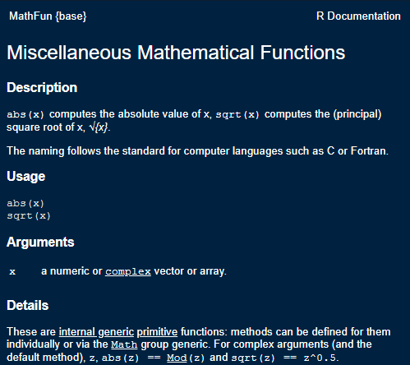
Functions and their arguments
?sqrt
a <- sqrt(100)
a

Slide 47
Functions and their arguments
?round
Syntax: round(x, digits = 0)
Arguments
x a numeric vector
digits integer indicating the number of decimal places
round(3.14159, digits = 0)
round(3.14159, digits = 2)

Slide 48
Q & A
What are some common functions you use?

Slide 49
Common functions you may use
Some common functions you may use:
mean()
median()
mean()
max()
summary()

Slide 50
Missing data
Missing data are represented in vectors as NA
Most functions will return NA if the data you work with contains missing values. You can add the argument na.rm = TRUE to calculate the result that ignores the missing value

Slide 51
Let’s add a row to our first_df
The pipe operator %>% allows us to chain a series of commands.
Takes output on the left of %>% as the input of the function on the right
No assignment operator
first_df %>%
add_row(countries = "Peru", emissions = NA)
first_df

Slide 52
Let’s add a row to our first_df
With assignment operator
first_df <- first_df %>%
add_row(countries = "Peru", emissions = NA)
first_df

Slide 53
Missing data
To take the mean of emissions, we use the mean() function
mean(first_df$emissions)
mean(first_df$emissions, na.rm = T)

Slide 54
Replacing missing values
Let’s say we were told that Peru’s emissions are 100.
first_df %>%
mutate(emissions = ifelse(countries == "Peru", 100, emissions))
first_df # why has it not changed?

Slide 55
Replacing missing values
Alternate way of doing it
first_df$emissions[is.na(first_df$emissions)] <- 100
This coding style may be more similar to what you may see in FRE 501.
Notes:
Easily drop

Slide 56
Writing your own functions
Sometimes, you will find it useful to write your own functions.
The syntax of a function is
function_name <- function(arg1, arg2, …){
statements # do something interesting
object # return value
}
Use a meaningful name to call your function
compute_standard_error instead of func1

Slide 57
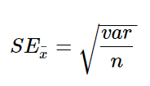
Writing your own functions
R does not have a built in function to calculate standard errors.
sqrt(var(first_df$emissions, na.rm = T) / length(first_df$emissions))
Notes:
Treating NA’s

Slide 58
Writing your own functions
But what if you have to compute the SE for multiple variables?
Copy pasting the formula and editing variable names can lead to mistakes

Slide 59
Writing your own functions
Write your own function instead
std_error <- function(x){
sqrt(var(x, na.rm = T) / length(x))
}
std_error is the function name
x is the argument, which is a numeric vector in this example
Every time we pass a vector to this function, it will compute the formula provided in the body of the function.

Slide 60
Writing your own functions
Let’s add the country’s GDP to first_df using the add_column() function. Then calculate its standard error.
first_df <- first_df %>%
add_column(gdp = c(50300, 1090, 52100, 6110))
std_error(first_df$gdp)
std_error(first_df$emissions)

Slide 61
Best practices
It is recommended to write your functions at the top of your script.
If you write a bunch of related functions, save these functions in a separate script.
You can call these functions into your current script using the source() function.

Slide 62
Importing a function
source(here(“code”, “price_function.R”))
You will now see a get_delta() function in your Environment

Slide 63
What we just did
Create, name, and assign values to objects
Use comments to inform script
Inspect, manipulate, and subset vectors, lists, and data frames
Call functions and use arguments to change default options
Deal with missing values in objects
Write your own function
Import your own function
Notes:
Phrase this as a question?

Slide 64
Day 2

Slide 65
Functions
Why do we use functions?
Reduce likelihood of errors!

Slide 66
Standard Errors
first_df <- data.frame(countries = c(“Canada”, “Kenya”, “United States”, “Peru”), emissions = c(53700, 14300, 5250000, NA), gdp = c(250, 100, 350, 120))
first_df
Using yesterday’s formula, calculate SE of (1) emissions, and (2) gdp
sqrt(var(first_df$emissions, na.rm = T) / length(first_df$emissions))
sqrt(var(first_df$gdp, na.rm = T) / length(first_df$gdp))

Slide 67
Q: Ignoring NA in SE calculation
Oliver’s suggestion
Denominator = length – number of NA
length(first_df$emissions) – sum(is.na(first_df$emissions)
I misplaced my parentheses yesterday
sqrt(var(first_df$emissions, na.rm = T) / (length(first_df$emissions) - sum(is.na(first_df$emissions))))

Slide 68
Q: Ignoring NA in SE calculation
Ana’s suggestion
use the na.omit() function
sqrt(var(first_df$emissions, na.rm = T) / length(na.omit(first_df$emissions)))

Slide 69
Functions
Instead of repeating the code twice and just changing the variable name (e.g. emissions and gdp), we create a function
sqrt(var(first_df$emissions, na.rm = T) / length(na.omit(first_df$emissions)))
std_error <- function(x){
sqrt(var(x, na.rm = T) / length(na.omit(x)))
}

Slide 70
Without Using Functions
Wrong functions:
sqrt(var(first_df$emissions, na.rm = T) / length(first_df$emissions))
sqrt(var(first_df$gdp, na.rm = T) / length(first_df$gdp))
Correct functions:
sqrt(var(first_df$emissions, na.rm = T) / length(na.omit(first_df$emissions)))
sqrt(var(first_df$gdp, na.rm = T) / length(na.omit(first_df$emissions)))

Slide 71
But if you used a function
Just change the one in red
std_error <- function(x){
sqrt(var(x, na.rm = T) / length(na.omit(x)))
}
std_error(first_df$emissions)
std_error(first_df$gdp)

Slide 72
Q: How to drop certain rows?
first_df <- data.frame(countries = c("Canada", "Kenya", "United States", "Peru"), emissions = c(53700, 14300, 5250000, NA))
first_df
first_df <- first_df %>%
add_row(countries = "Philippines", emissions = 200) %>%
add_row(countries = "Philippines", emissions = 10000) %>%
add_row(countries = "Mexico", emissions = 200)

Slide 73
Q: How to drop certain rows?
# drop row five
no_row_5 <- first_df[-5,]
no_row_5
Notice that we no longer have a row with index 5
Google how to reset row index after dropping row in R
Notes:
Rownames(no_row_5) <- NULL

Slide 74
Q: How to drop certain rows?
Let’s say I want to drop rows 1, 3, 5
subset_1 <- first_df[-c(1,3,5),]
{dplyr} way – use slice()
Row index reset
subset_1a <- first_df %>%
slice(-c(1,3,5))

Slide 75
Q: How to drop certain rows?
I want to drop from rows 4 onwards
subset_2 <- first_df[-c(4:nrow(first_df)),]
subset_2a <- first_df %>%
slice(-(4:n()))

Slide 76
Q: How to drop certain rows?
What are potential issues with dropping rows based on index?

Slide 77
Q: How to drop certain rows?
What are potential issues with dropping rows based on index?
What if you sorted data differently?

Slide 78
Q: How to drop certain rows?
Let’s sort the countries column alphabetically then drop rows 1, 3 ,5
subset_1b <- first_df %>%
arrange(countries) %>%
slice(-c(1, 3, 5))
subset_1b
subset_1a

Slide 79
Q: How to drop certain rows?
So it is still best to drop rows using a unique identifier
Drop Philippines with emissions = 200
first_df %>%
filter(countries != “Philippines” | emissions != 200)

Slide 80
Q: coding in editor vs console
Editor
Anytime you type code here, R will not automatically run that line of code for you
You can save your code an return to it later
Console
Anytime you type code here, R will automatically run that line of code when you click ‘enter’
Codes run here will be ‘forgotten’ by R once you close or restart your session
Use it for quick calculations, quick view, etc.

Slide 81
Importing Data
Load data in different ways
Flat files (csv and txt)
Excel file (xlsx)
Stata data format (dta)
Google Sheet
API

Slide 82
Flat files
csv files
carbon <- read_csv(here("data", "yearly_co2_emissions.csv"))
carbon <- read.csv(here("data", "yearly_co2_emissions.csv"), sep = ",", header = TRUE)
sep = “,” means that the data is comma delimited
header = TRUE indicates that the first row is variable names

Slide 83
Flat files
Txt files
provinces <- read.table(here("data", "province.txt"), sep = "\t", header = TRUE)
sep = “\t” means that the data is tab delimited
header = TRUE indicates that the first row is variable names

Slide 84
Excel files
xlsx files
gdp <- read_xlsx(here("data", "gdp_pc.xlsx"))
If data is stored in separate sheets,
energy_hist <- read_xlsx(here("data", "energy_use_per_person.xlsx"), sheet = 1)
energy_recent <- read_xlsx(here("data", "energy_use_per_person.xlsx"), sheet = 2)
Part of {readr} package

Slide 85
Merge
Let’s merge or join the two energy files we just loaded into R.
energy <- full_join(energy_hist, energy_recent, by = c("country"))
energy_basemerge <- merge(energy_hist, energy_recent, by = c("country"), all.x = TRUE, all.y = TRUE)

Slide 86
Stata files
Stata files
politics <- read.dta13(here("data", "politics.dta"), nonint.factors = TRUE)
The argument `nonint.factors = TRUE` is to keep factor labels instead of the value itself. You can try loading the data with and without that argument to see the difference.

Slide 87
Google Sheets
gs4_deauth() # so no need to sign in
disasters <- read_sheet("https://docs.google.com/spreadsheets/d/17s15o7jdDpGSKgsIboZdnYU2UxHtU9DHKNRmYVVgwJo/edit#gid=0", skip = 2)
The argument “skip = 2” tells R to start reading the data from the third row.

Slide 88
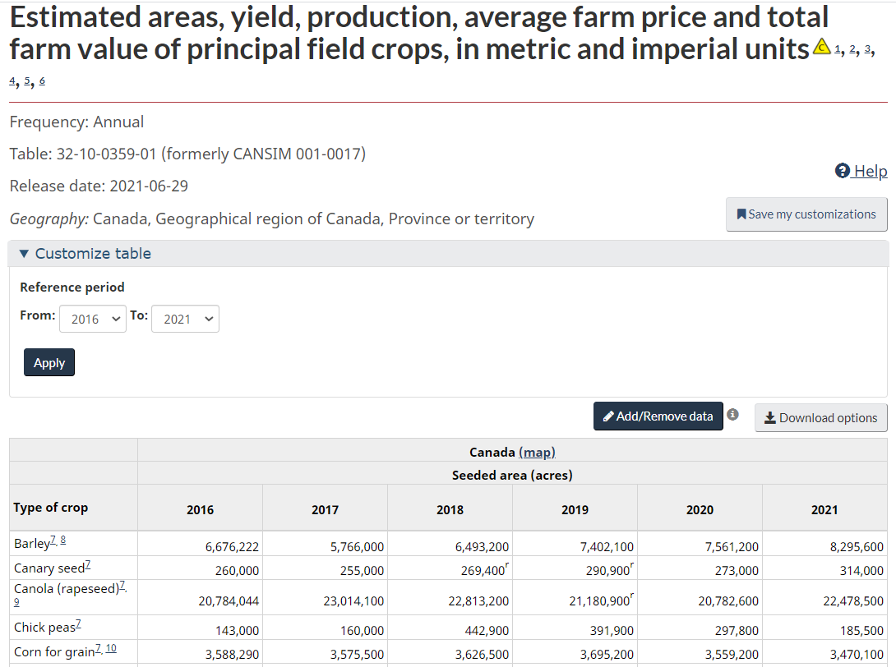
API
Let’s say you want to work with this table from Statistics Canada.

Slide 89
API
You can download the Excel file, save it in your computer, and load it using one of the functions discussed earlier.
Or you can use the {cansim} package which connects straight to the Statistics Canada database.
ag <- get_cansim('32-10-0359-01')

Slide 90
What we just did
Load data in different ways
Flat files (csv and txt)
Excel file (xlsx)
Stata data format (dta)
Google Sheet
API

Slide 91
Viewing your data
You can view your data with the command View(dataframe_name) or by clicking the data object in your Environment tab
The ability to click and look at your data is an advantage of using an Rstudio over R.

Slide 92
Inspecting your data
Here are a few functions to inspect your data
Size
dim(politics)
nrow(politics)
ncol(politics)
Content
head(politics) or tail(politics)
politics %>% slice_head(n = 7)
politics %>% slice_sample(n = 10)

Slide 93
Inspecting your data
Column Names
names(politics)
Summary
str(politics)
summary(politics)
glimpse(politics)

Slide 94
Subsetting Data Frames
Recall that we use [ ], [[ ]], or $ to extract certain columns and rows from our data frame.
politics[1, 2]
politics[c(5:10), ] #extract rows 5-10 and all columns
politics[c(5:10), c(1:3)] #extract rows 5-10 and columns 1-3
politics$country #extract the country column **
table(politics$country)

Slide 95
Q & A
How would you describe the carbon and gdp data frames?
How are they similar/different from the politics data frame?

Slide 96
Research Question
From this point on, we will just look at the carbon, gdp, and politics data frames.
We want to explore the following research questions:
Do richer countries emit more carbon emissions?
If we have time: How does a country’s level of democracy affect emissions?

Slide 97
Tidy Data
Now that we have our data in R and know what it looks like, we want to make sure that the data is in tidy format before we proceed with any analysis.

Slide 98
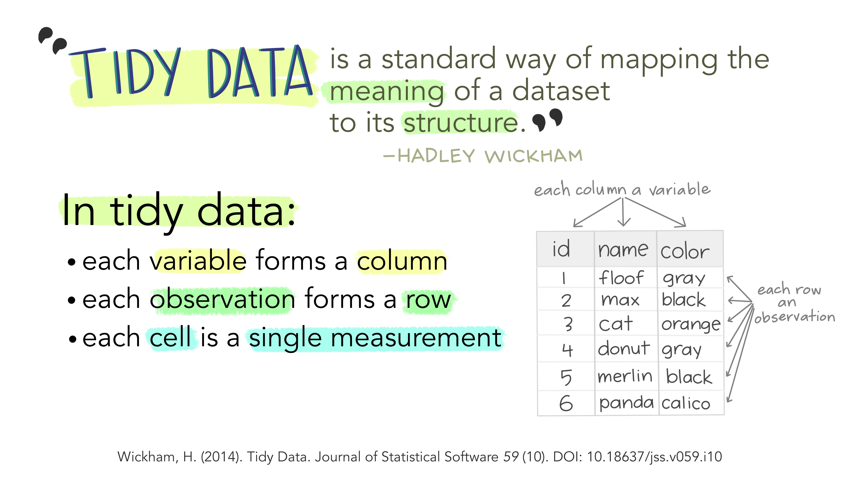
Tidy data
"Illustrations from the Openscapes blog Tidy Data for reproducibility, efficiency, and collaboration by Julia Lowndes and Allison Horst"

Slide 99
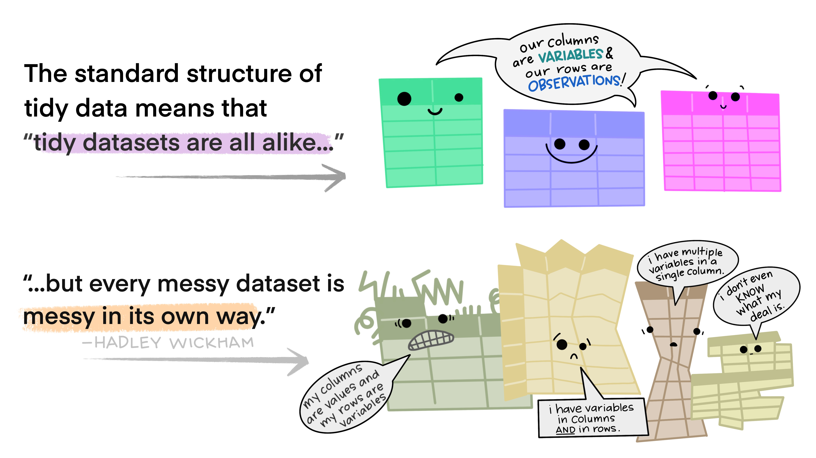
Tidy data

Slide 100
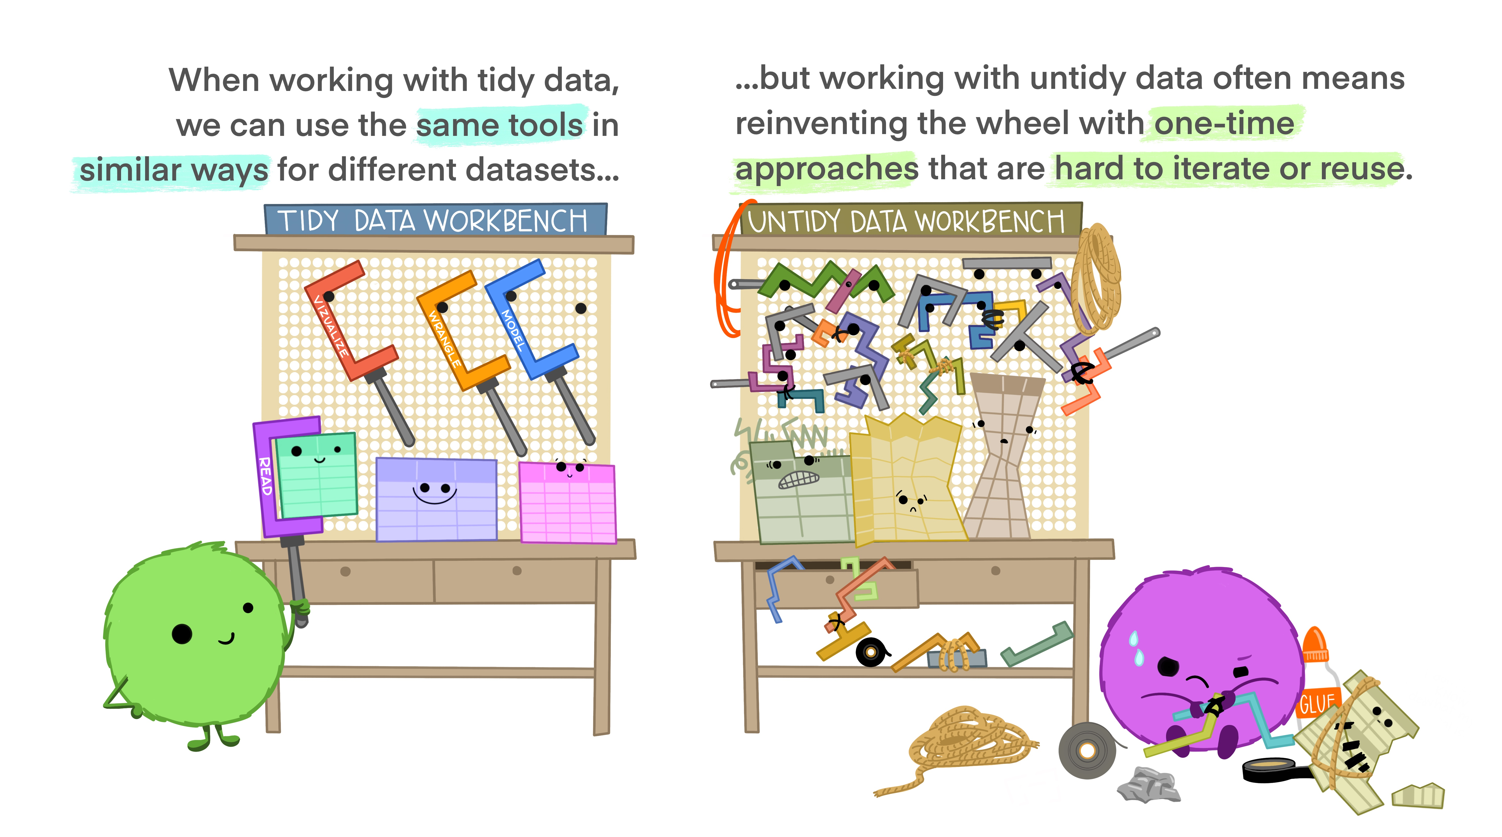
Tidy data

Slide 101

Tidy data

Slide 102
Reshaping data
Politics data is in the “long” format
Each row contains the values of variables associated with each country and year
Data is in the tidy format
country | year | V2x_libdem
Myanmar | 2012 | 0.137
Myanmar | 1997 | 0.018

Slide 103
Reshaping data
Carbon and gdp data is in a “wide” format.
This format means that each variable (i.e. emissions for 1751, emissions for 1752, and so on) is listed as its own column.
Data is not tidy
R functions expect your data to be in the “long” format because it is more machine readable.
country | 1751 | 1752 | 1753
Afghanistan | NA | NA | NA
Albania | NA | NA | NA

Slide 104
Note on column names
You might notice that in the carbon and gdp data, the column names are numeric. This practice is not recommended.
To refer to these columns, you will have to wrap them with backticks (`)
carbon$`2014`

Slide 105
Reshaping data
We want to convert carbon to a “long” format to make it more useful for visualization and analysis.
A “long” format means that we will have fewer columns than the current format (“wide”)
We want to collapse all emissions across the years into one new variable called “emissions.”
We identify what year the data point is from by creating a “year” variable

Slide 106
Reshaping data
country | 1751 | 1752 | 1753
Afghanistan | a | b | c
Albania | d | e | f
country | Year | emissions
Afghanistan | 1751 | a
Afghanistan | 1752 | b
Afghanistan | 1753 | c
Albania | 1751 | d
Albania | 1752 | e
Albania | 1753 | f

Slide 107
Reshaping data
We will use the pivot_longer() function.
4 arguments
The wide data
cols are the names of the columns we will use (or not use) to fill the new values variable
names_to refers to the column variable we wish to create the cols provided
values_to refers to the column variable we wish to create and fill with the values associated with the cols provided

Slide 108
Reshaping data
Looking at our carbon data,
4 arguments
wide data – carbon
cols - all columns except country, so –country
names_to – collapse all years to a new column called year
values_to – collapse all emissions values to a new column called emissions

Slide 109
Data Wrangling – reshaping data
carbon_long <- carbon %>%
pivot_longer(cols = -country,
names_to = “year”,
values_to = “emissions”)

Slide 110
Reshaping data
Always good to check if you did it correctly
carbon_long %>% slice_sample(n = 10)
Compare the dimensions of the carbon and carbon_long data frames.
How would you check for this?

Slide 111
Reshaping data
If you take a look at the structure of the data, you will notice that R encoded the year variable as character instead of numeric.
To create or modify columns, use the mutate() function.
carbon_long <- carbon_long %>%
mutate(year = as.numeric(year))
## carbon_long$year <- as.numeric(carbon_long$year)

Slide 112
Reshaping data
The gdp data is also in the same format. Let’s reshape it too. Notice the use of the %>%.
gdp_long <- gdp %>%
pivot_longer(cols = -country,
names_to = "year",
values_to = "gdp") %>%
mutate(year = as.numeric(year),
gdp = as.numeric(gdp))
head(gdp_long)

Slide 113
Reshaping data
In case you need to reshape the data into wide format, read the notes!

Slide 114
Selecting and Filtering
Let’s say you only want to keep certain variables from the politics data. You can use the select() function to perform this task.
You can add a minus sign in front of a variable to drop a variable
politics %>% select(country_name, year, v2x_libdem, v2x_regime, region)
politics %>% select(-v2psnatpar_ord)

Slide 115
Selecting and Filtering
The output of the codes we just ran will just print the data frame.
To save the new data frame, we have to use the assignment operator. We will just overwrite the original politics data.
politics <- politics %>% select(country_name, year, v2x_libdem, v2x_regime, region)

Slide 116
Selecting and Filtering
We can use the filter() function to filter observations.
Min(politics$year, na.rm = T)
Max(politics$year, na.rm = T)
politics <- politics %>% filter(year >= 1991 & year <= 2014)
politics %>% filter(region == "Africa")

Slide 117
Selecting and Filtering
You can also use the %>% to chain the commands
politics <- politics %>%
select(country_name, year, v2x_libdem, v2x_regime, region) %>%
filter(year >= 1991 & year <= 2014)

Slide 118
Renaming columns
To rename variables, the syntax is rename(new_name = old_name)
politics <- politics %>%
rename(country = country_name,
democracy = v2x_libdem,
regime = v2x_regime)
## also does the same thing names(politics)[which(names(politics) == "country")] = "country"

Slide 119
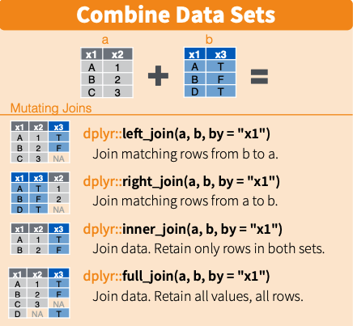
Joining data together

Slide 120
Joining data together
I want to keep all the observations in the carbon_long data, and join/merge with the gdp_long and politics data
data <- carbon_long %>%
left_join(gdp_long, by = c("country", "year")) %>%
left_join(politics, by = c("country", "year")) %>%
filter(!is.na(emissions) & !is.na(region) & !is.na(gdp)) %>%
filter(year >= 1991 & year <= 2014)

Slide 121
Another way to join
Use the merge() function
carbon_gdp <- merge(carbon_long, gdp_long, by = c("country", "year"), all.x = TRUE)
merged <- merge(carbon_gdp, politics, by = c("country", "year"), all.x = TRUE)

Slide 122
Creating new variables
Let’s say we want to create a new variable.
data <- data %>%
mutate(gdp_sq = gdp * gdp)
Or
data$gdp_sq <- data$gdp * data$gdp
Notes:
https://hhsievertsen.github.io/applied_econ_with_r/#5_Descriptive_Charts

Slide 123
Descriptive statistics
We can show some summary statistics using the following commands
mean(data$emissions, na.rm = T)
table(data$country)
summary(data)
summary(data$emissions)

Slide 124
Descriptive statistics
We can also compute summary statistics by region using group_by() and summarize() functions
data %>% group_by(region) %>%
summarize(n = n(),
avg_emissions = mean(emissions, na.rm = T),
median_gdp = median(gdp, na.rm = T))

Slide 125
Descriptive statistics
You can also use the arrange() function to sort values.
data %>% group_by(region) %>%
summarize(n = n(),
avg_emissions = mean(emissions, na.rm = T),
median_gdp = median(gdp, na.rm = T)) %>%
arrange(desc(median_gdp), desc(avg_emissions))

Slide 126
Descriptive statistics
We can use the {modelsummary} package to generate nice looking tables. Read here for more ways to customize your table.
datasummary_skim(politics)
datasummary_skim(data, type = "categorical")
# To export
datasummary_skim(data, output = here("output", "categorical_summary_statistics.html"))

Slide 127
Data Visualization
There are {base} R functions to plot data, such as plot() and hist()
We will focus on ggplot2. Read this tutorial/book for an in-depth intro.
ggplot2 is based on the “Grammar of Graphics that allows you to compose graphs by combining independent components...The grammar tells us that a graphic maps the data to the aesthetic attributes (color, shape, size) of geometric objects (points, lines, bars)”

Slide 128
Data Visualization
There are 3 main components in every ggplot2 plot.
The data
A set of aesthetic mapping
At least one layer that describes how to render each observation
Common layers
geom_line() for trend lines, time series, etc
geom_point() for scatter plots
geom_boxplot() for boxplots
geom_bar() and geom_col() for bar charts
geom_histogram() for histograms

Slide 129
Scatterplots
Let’s try to visualize the relationship between the gdp and emissions variables in our data data frame (Sorry, should have named the data frame differently!)
The data = data
Aesthetics = gdp mapped to the x axis, emissions to the y axis
Layer = points or geom_point()

Slide 130
Scatterplots
options(scipen=99999) # turn off scientific notation
ggplot(data, aes(x = gdp, y = emissions)) +
geom_point()

Slide 131
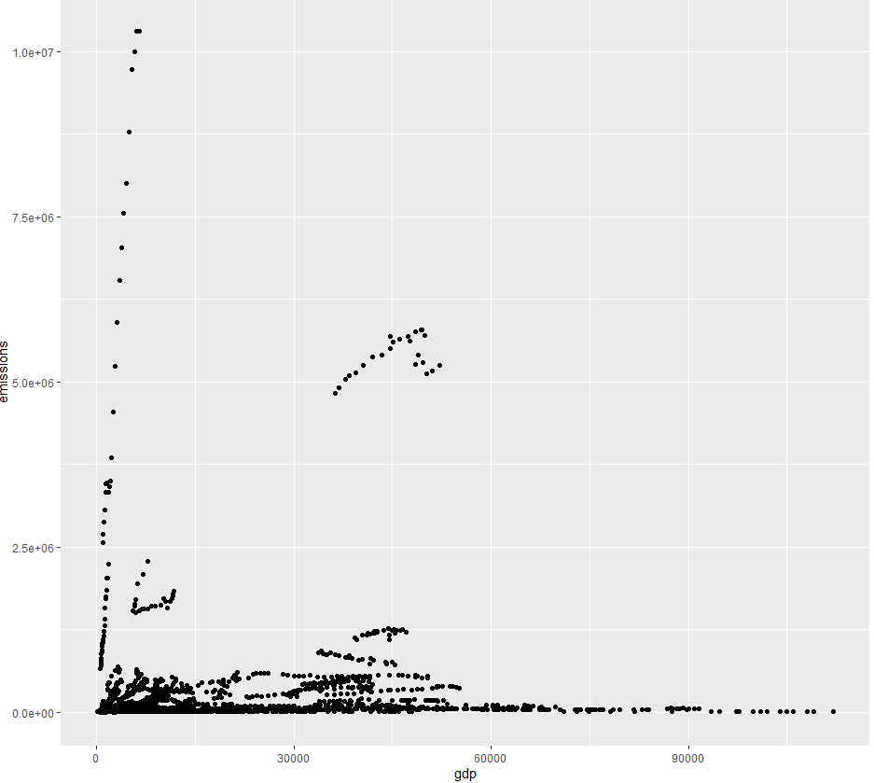

Scatterplots

Slide 132
Scatterplots
ggplot(data, aes(x = log(gdp), y = log(emissions))) +
geom_point()
The data and aesthetic are inside the ggplot() function. The layer is added with a +.
Since most maps plots a variable to x and y, first two arguments in aes() will be mapped to x and y.
ggplot(data, aes(log(gdp), log(emissions))) +
geom_point()

Slide 133
Scatterplots
We can also plot another variable to our plot by using other aesthetics such as color, shape, and size.
This code changes the color of the point based on the country’s region.

Slide 134
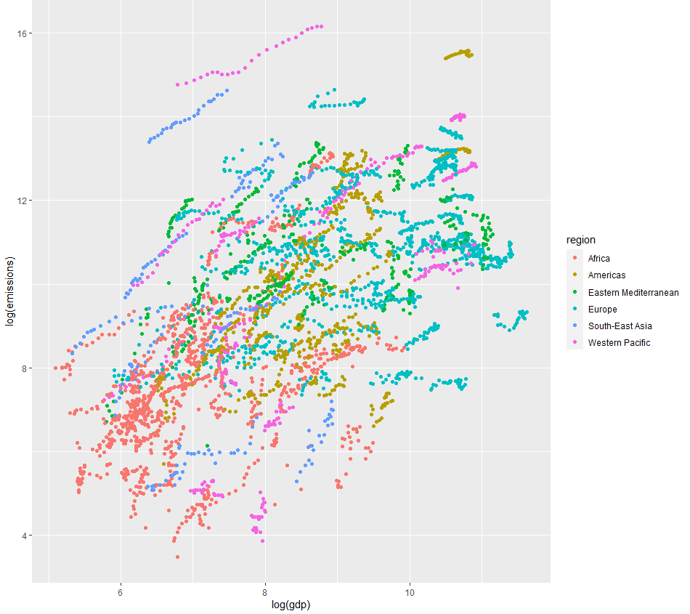
Scatterplots
ggplot(data, aes(log(gdp), log(emissions), color = region)) +
geom_point()

Slide 135
Scatterplots
We can also use the pipe operator with ggplot2. This method is useful if you want to make changes to the data (e.g. filter or mutate) before plotting.
Let’s calculate the average emissions and average GDP per country. Then plot it.
This will be my “base” graph so I will assign the plot to object p. I can add more layers to p later on.

Slide 136
Scatterplots
p <- data %>%
group_by(country) %>%
mutate(avg_emissions = mean(emissions, na.rm = T),
avg_gdp = mean(gdp, na.rm = T)) %>%
ggplot(aes(log(avg_gdp), log(avg_emissions))) +
geom_point()
p

Slide 137
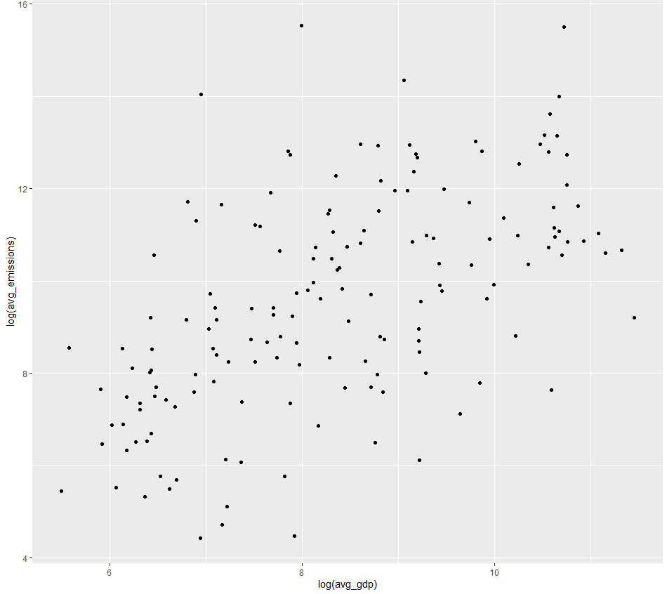
Scatterplots

Slide 138
Adding layers
We build our plots iteratively. Now let’s add a title and label the axes. Since we already saved the base plot to object p, we can just add layers to using +.
p <- p + labs(title = "Relationship between Emissions and GDP",
y = "Log GDP per capita", x = "Log CO2 per capita")
p

Slide 139
Adding a trend line
We can add a fitted line using geom_smooth(). If we want a fitted line based on a linear model, we have to specify it using geom_smooth(method = “lm”)

Slide 140
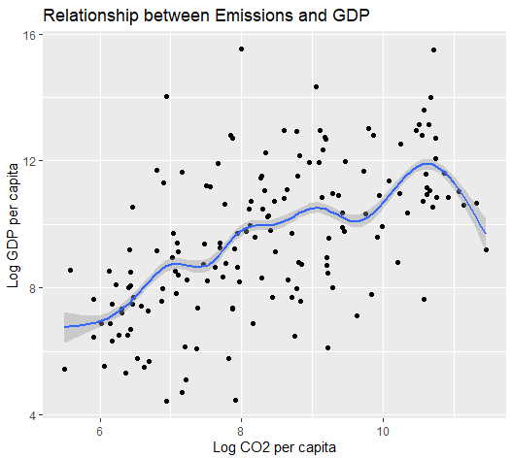
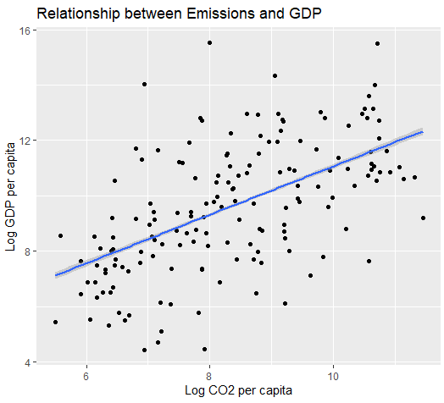
Adding a trend line
p + geom_smooth()
p + geom_smooth(method = “lm”)

Slide 141
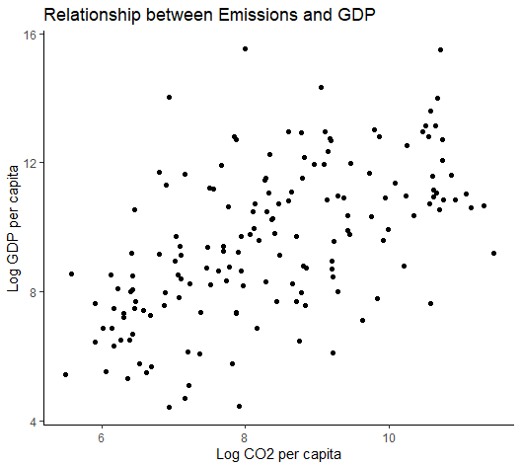
Changing the theme
There are different themes available. Let’s say we want to use the theme_classic()
“A classic-looking theme, with x and y axis and no grid lines”
p <- p + theme_classic()
p

Slide 142
Saving the plot
The recommended practice is to use the ggsave() function.
Use the Export button in the ‘Plots’ tab, but this action is not good for reproducibility.
Please don’t just take the a screenshot of the image!
Can save as png, jpg, pdf, etc.
ggsave(p, filename = here("output","emissions_gdp.png"))

Slide 143
Boxplots
bp <- data %>%
filter(year == 2010) %>%
ggplot(aes(region, gdp)) +
geom_boxplot() +
labs(title = "Distribution of GDP by Region, 2010",
y = "GDP per capita", x = "Region") +
theme_classic()
bp

Slide 144
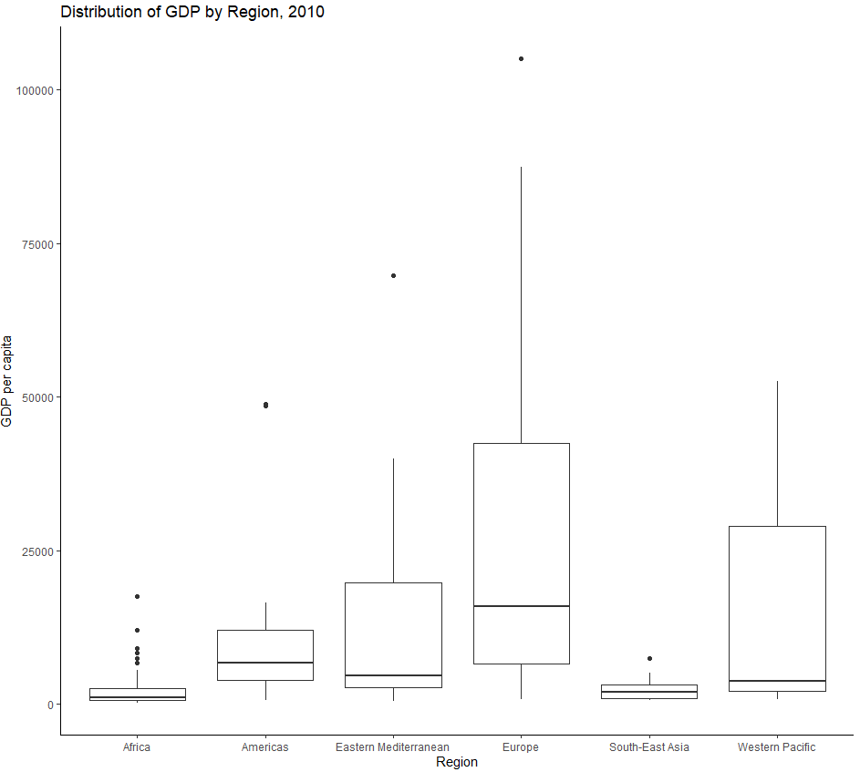
Boxplots

Slide 145
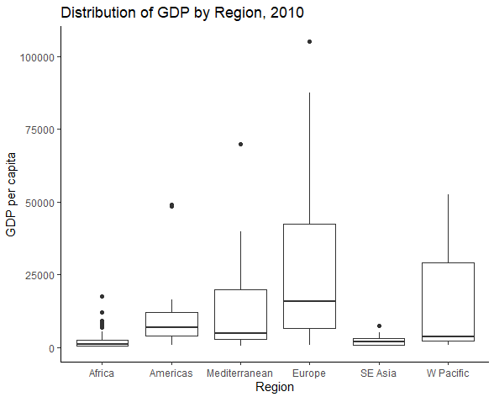
Edit the tick marks
bp + scale_x_discrete(labels = c("Africa", "Americas", "Mediterranean", "Europe", "SE Asia", "W Pacific"))

Slide 146
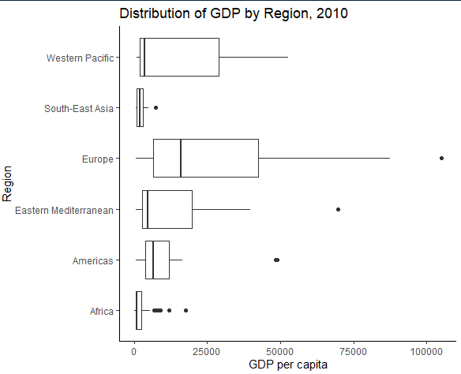
Flipping the coordinates
bp + coord_flip()

Slide 147
Line plots
Let’s plots Canada’s emissions over time
lp <- data %>%
filter(country == "Canada") %>%
ggplot(aes(x = year, y = emissions)) +
geom_line(linetype = "dashed", color = "red") +
theme_classic() +
labs(title = "Canada's CO2 emissions, 1991-2014",
y = "Total Emissions",
x = "Year")
lp

Slide 148
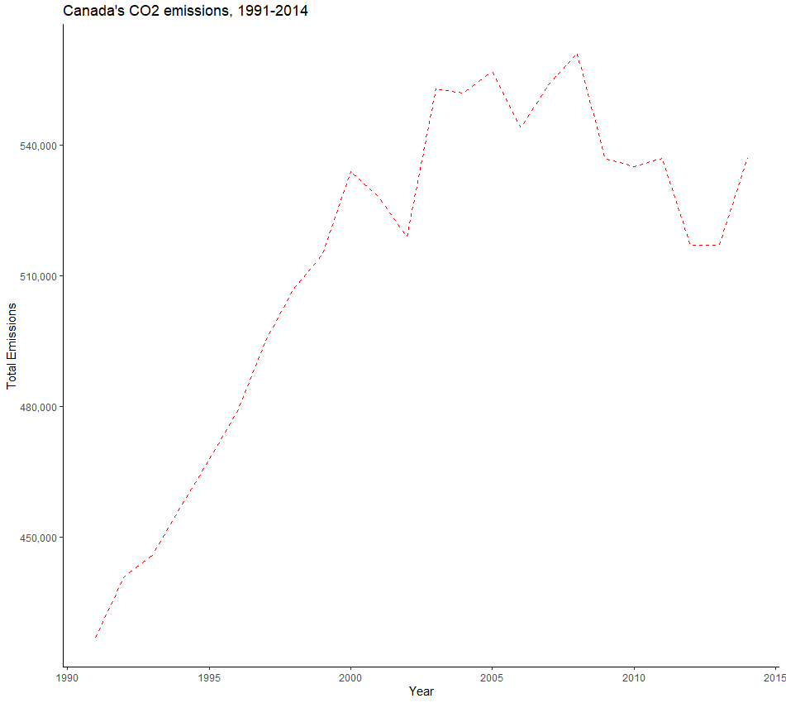
Adding a comma to the scale
lp + scale_y_continuous(labels = scales::comma)

Slide 149
Histogram
ggplot(data, aes(x = gdp)) +
geom_histogram() +
theme_classic() +
labs(title = "Income Distribution, 1991-2014",
y = "Count",
x = "GDP per capita")

Slide 150
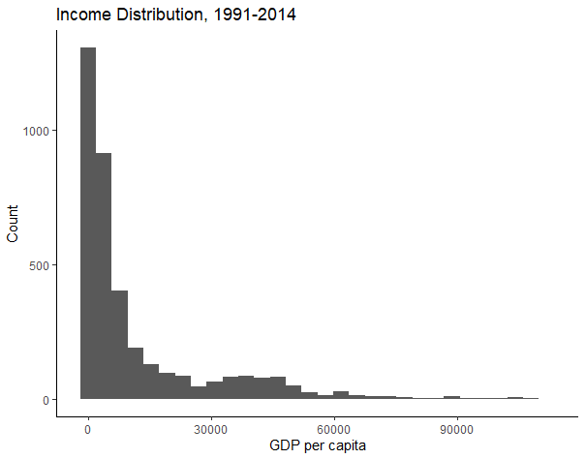
Histogram

Slide 151
Analysis
Pairwise t-test
Correlation
Regression

Slide 152
Comparing CAN & AUS
Let’s compare the carbon emissions of Canada and Australia.
data %>%
filter(country == "Canada" | country == "Australia") %>%
group_by(country) %>%
ggplot(aes(x = country, y = emissions)) +
geom_boxplot() +
labs(title = "Comparing Canada and Australia's emissions, 1991-2014",
y = "Emissions",
x = "Country")

Slide 153
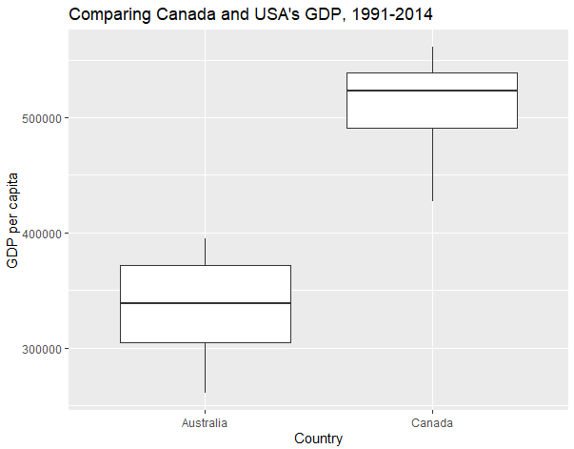
Comparing CAN & AUS

Slide 154
t-test
can_aus <- data %>%
filter(country == "Canada" | country == "Australia")
options(scipen = 0) # to allow for scientific notation again
can_aus_ttest <- t.test(emissions ~ country, data = can_aus)
can_aus_ttest

Slide 155
Correlation
How related are country’s average emissions and average GDP?
data <- data %>%
group_by(country) %>%
mutate(avg_emissions = mean(emissions, na.rm = T),
avg_gdp = mean(gdp, na.rm = T))

Slide 156
Correlation
cor <- cor.test(data$avg_emissions, data$avg_gdp, method = "pearson")
cor
str(cor)
cor$estimate

Slide 157
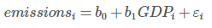
Regression
reg1 <- lm(emissions ~ gdp, data = data)
reg1
summary(reg1)
str(summary(reg1))
summary(reg1)$coefficients

Slide 158
Exporting results
tidy_reg1 <- tidy(reg1)
write_csv(tidy_reg1, file = here("output", "tidy_reg1.csv"))
modelsummary(reg1,
coef_rename = c("gdp" = "GDP", "(Intercept)" = "Intercept"),
stars = TRUE, statistic = 'std.error',
fmt= '%.4f',
gof_omit = 'DF|AIC|BIC|Log|R2 Adj.',
output = 'flextable')

Slide 159
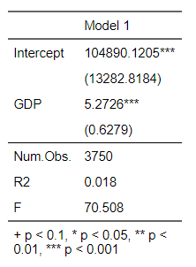
Exporting results

Slide 160
What we just did
Conduct pairwise t-test
Calculate the correlation coefficient
Run an OLS regression in R

